Slide 1

CONTROL STRUCTURE IN PHP

Slide 2

Present By: Jusayan, Juvelyn s. BSIT-2A
Present To: Nitura, Jayson

Slide 3
Control Structure - Code execution can be grouped into as shown below. categories
Sequential - this one involves executing all the codes in the order in which they have been written.
Decision - this one involves making a choice given a number of option. The code executed depends on the value of the condition.

Slide 4
PHP IF Else If… then... else is the simplest control structure. It evaluates the conditions using Boolean logic When to use if… then… else You have a block of code that should be executed only if a certain condition is true You have two options, and you have to select one. If… then… else if… is used when you have to select more than two options and you have to select one or more

Slide 5
Syntax The syntax for if… then… else is;
<?php
if (condition is true) {
block one
else
block two
}
?>

Slide 6
HERE, “if (condition is true)” is the control structure “block one” is the code to be executed if the condition is true {…else…} is the fallback if the condition is false “block two” is the block of code executed if the condition is false

Slide 7
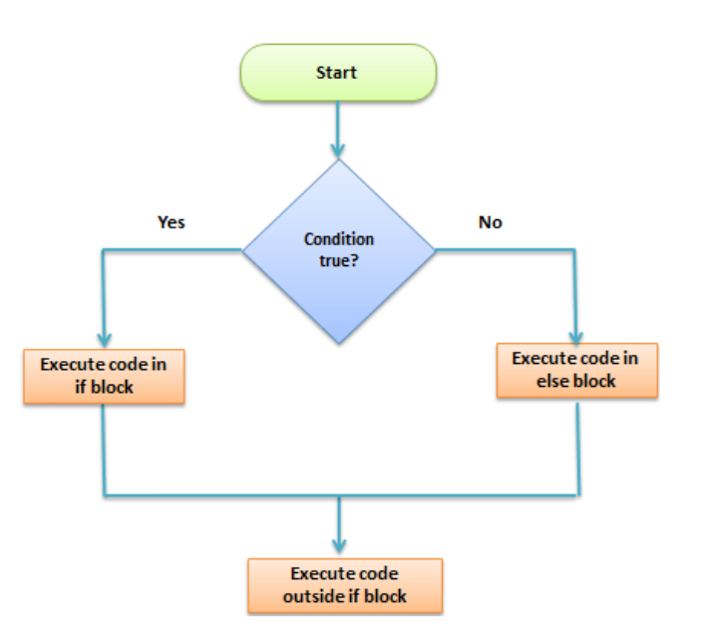
How it works The flow chart shown below illustrates how the if then… else control structure works

Slide 8
Let’s see this in action The code below uses “if… then… else” to determine the larger value between two numbers. <?php $first_number = 7; $second_number = 21; if ($first_number > $second_number){ echo "$first_number is greater than $second_number"; }else{ echo "$second_number is greater than $first_number"; } ?>

Slide 9
PHP Switch Case Switch… case is similar to the if then… else control structure. It only executes a single block of code depending on the value of the condition. If no condition has been met then the default block of code is executed.

Slide 10
It has the following basic syntax. <?php switch(condition){ case value: //block of code to be executed break; case value2: //block of code to be executed break; default: //default block code break; } ?>

Slide 11
HERE, “switch(…){…}” is the control structure block code “case value: case…” are the blocks of code to be executed depending on the value of the condition “default:” is the block of code to be executed when no value matches with the condition

Slide 12
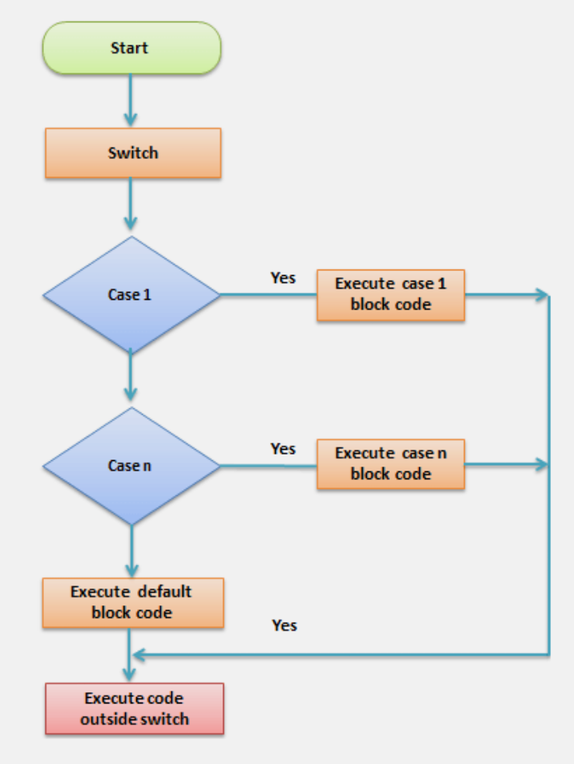
How it works The flow chart shown below illustrates how the switch control structure works

Slide 13
The code below uses the switch control structure to display a message depending on the day of the week. <?php $today = "wednesday"; switch($today){ case "sunday": echo "pray for us sinners."; break; case "wednesday": echo "ladies night, take her out for dinner"; break; case "saturday": echo "take care as you go out tonight."; break; default: echo "have a nice day at work"; break; } ?>

Slide 14
Control structures are used to control the execution of the program The if then... else is when you have more than route block of code to execute depending on the value of the condition Switch… case is used to when you have a number of block codes, and you only have to execute one of them depending on the value of the set case.

Slide 15
THANK YOU !

